Slide 1

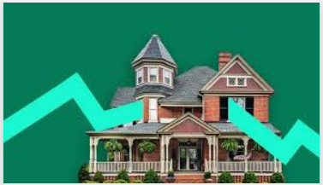
Housing Rate Prediction Model
Deepti Sonth – 001448813
Rajavi Mehta – 001057845
Naqiyah Lakdawala - 001449938
Priyanshi Agrawal – 001840704

Slide 2
Introduction
To predict the average price of a house in a block based on several features in real - life scenarios. In all model building assumptions are made, and certain conditions also required to be approximately met for purposes of estimation and meeting certain accuracy levels..
This dataset was derived from the 1990 U.S. census, using one row per census block group. A block group is the smallest geographical unit for which the U.S.Census Bureau publishes sample data
The target variable is the price of the house that is to be predicted.

Slide 3
Problem Objective
The United States housing bubble was a real estate bubble affecting over half of the U.S. states. Housing prices peaked in early 2006, started to decline in 2006 and 2007, and reached new lows in 2012. Affecting the world’s real estate conditions to worsen.
Having a predictive model in which the housing rate of the houses is determined by overall variables, surrounding the region provides a sense of stability in the market and overall financial stability for an individual.
Thus the objectives for the project is to provide top most accuracy for the target variable i.e the house rate value according to the surrounding parameters such as the region, the age factor of the building, number of rooms, bedrooms, type of house and other house properties.

Slide 4
Data Set intro
The dataset consists of the following columns:
Suburb: Suburb where the house is located
Address: Address of the house
Rooms: Number of rooms in the house
Price: Price of the house in dollars
Method:
Type:
SellerG: Real Estate Agent
Date: Date the house was sold
Distance: Distance from Central Business District
Regionname: General Region (West, North West, North, North east ...etc)
Propertycount: Number of properties that exist in the suburb.
Bedroom2 : Number of Bedrooms in the house
Bathroom: Number of Bathrooms in the house
Car: Number of carspots in the building available to the residents
Landsize: Size of the Land
BuildingArea: Size of the Building
YearBuilt: Year the house was built
CouncilArea: Governing council for the area
Latitude: Location of the building latitude
Longitude: Location of the building in longitude
Postcode : Postcode of the location of the houses

Slide 5
Methodologies & Algorithms
Exploratory Data Analysis: The Dataset we are using is a housing rate data set which allows us to predict the accuracy of the house rates value according to the parameters available to us in the data set. In EDA , we clean and explore each feature used in the dataset and detect anomalies
Feature Engineering: Transforming the columns and handling null values
Feature Selection: Selecting only the relevant variables for our prediction
Correlation of data variables: Finding correlation between different variables in a dataset
Supervised Learning Data Algorithms - Advanced regression techniques like random forest and gradient boosting, Lasso & Ridge and linear Regression.
Unsupervised Learning Data - Clustering or Dimension Structure Reduction
Visualization: Plotting and analysing of Descriptive and target variables using matplotlib and Seaborn
Hypertuning of Parameters: To increase the accuracy of model predictions (Using Random Forest & gradient boosting Regressor)
Optimal Model for Prediction - Gradient boosting regressor

Slide 6
Exploratory Data Analysis
The entire dataset is comprised of 21 variables with 8 variables as characters or strings
The key prediction variable is the Price of the houses so keeping in mind the key variable we eliminated all the rows with the missing values of the data
Secondly we cleaned the data using the analysis that the total number of rooms comprises of bedrooms and bathrooms in the dataset.
Therefore deriving from the conclusion that rooms is the sole column having the most significance to the pricing variable we eliminated the column of the bedroom.
Further analyzing the data we discovered that the land size and the building area of the houses had some discrepancies which lead us to make changes to the dataset, we derived a columns to eliminate the null values and brought down the dataset . We also observed that in some rows the building area was > then the landsize which is not possible and had false values which forced us into eliminate these values and thus making the dataset cleaner we calculated these values and eliminated those.
Lastly we discovered the age of the property and by deriving the year it was built in and the current year . Concluding, to add the House age as one of the main columns correlating to the price of the house.

Slide 7
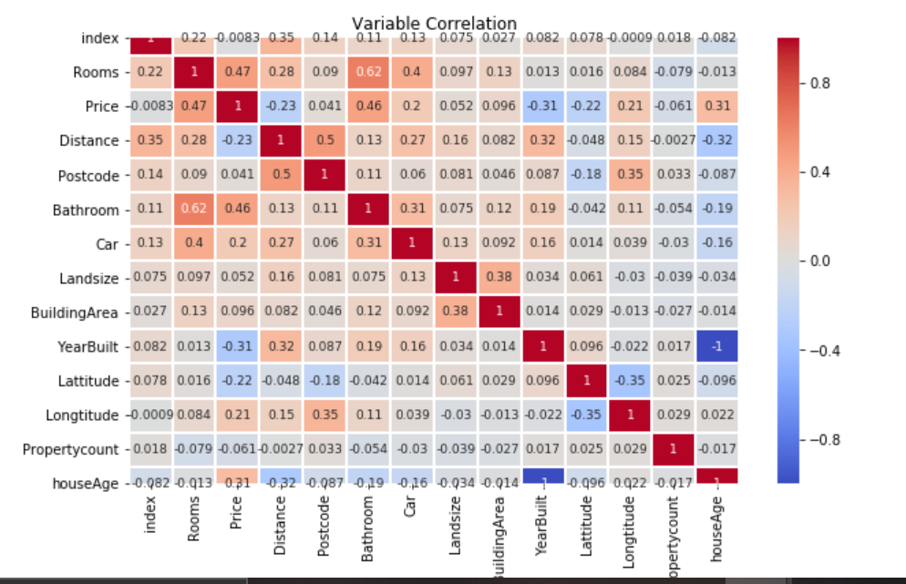
Graph for Variable Correlation

Slide 8
We carried out the correlation matrix in which we discovered that All of the above were numerical values and thus were directly correlating to the significance of the pricing of the housing .The columns contributing the most are:
Rooms
Bathrooms
Building Area
HouseAge
YearBuilt
Distance
Price
But we cannot rely only on all numerical values for the prediction of the housing thus we decided to add categorical values adding to the significance .
Converting the values into the data type categorical values we added ,
Type of the houses.

Slide 9
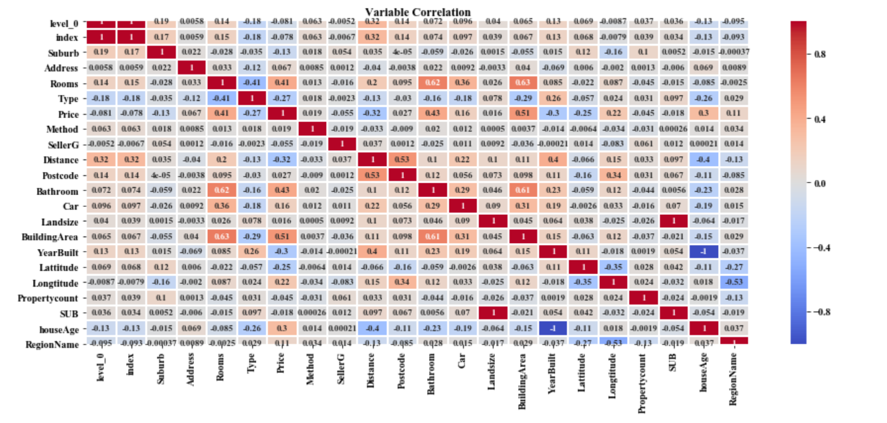

Slide 10
Clustering (k means)
The next step would be to treat every row of the data as vectors in pursuit of finding properties which are similar to each other. The algorithm used to achieve this feat is K means Clustering.
Cleaning Data: For clustering, data must be indeed integers. Moreover, since k-means is using Euclidean distance, having categorical column is not a good idea. We normalized the dataset which would have a certain set of variables chosen.
The variable ‘Date’ in its standard format will not be fed well in the model so we made a new column which encodes the month of the date present and dropped the former.
Choose Number of Clusters and Standardize Data - For choosing the number of clusters k, we use the Elbow method. Elbow method tries different values of k and plot the average distance of data points from their respective centroid (average within-cluster sum of squares) as a function of k.
We have also standardized the data to counter the high influence by variables having unusual scales then the rest.

Slide 11
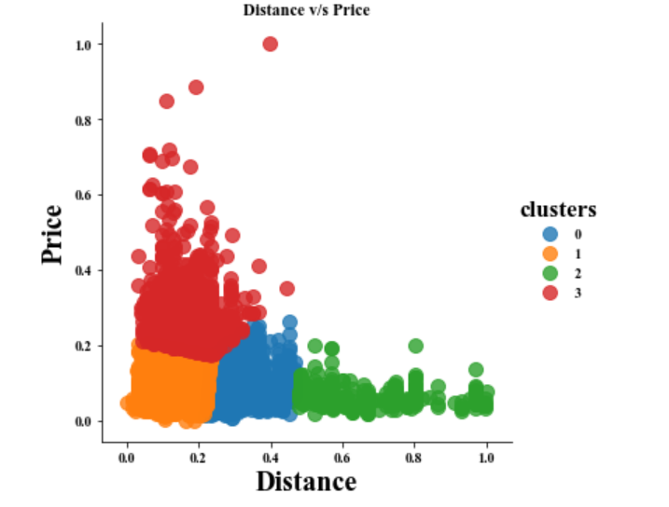
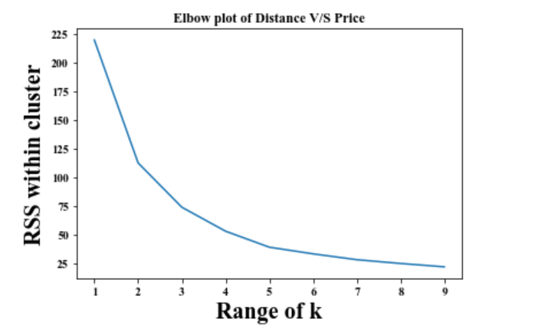
Distance Vs Price

Slide 12
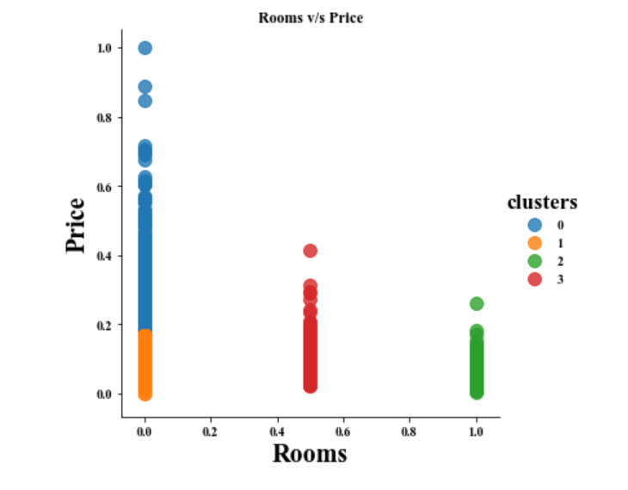
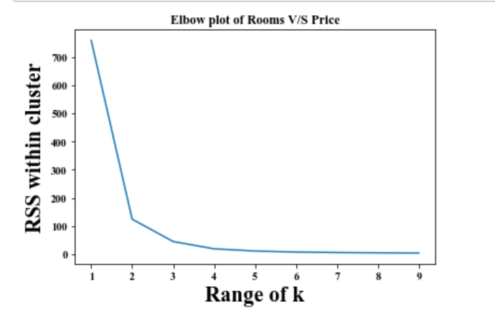
Rooms Vs Prices

Slide 13
Linear Regression
Multiple linear regression (MLR), also known as multiple regression, is a statistical technique that uses several independent variables to predict the outcome of a dependent variable. The goal of multiple linear regression (MLR) is to model the linear relationship between the independent variables and dependent variable.
The multiple regression model is based on the following assumptions:
There is a linear relationship between the dependent variables and the independent variables.
The independent variables are not too highly correlated with each other.
y_{i} observations are selected independently and randomly from the population.

Slide 14
The Formula for Multiple Linear Regression Is:
y = m1x1 + m2x2+ m3x3+……mixi +b + r
Where,
y= the dependent variable of the regression
mi= slope of the regression for that variable
xi= independent variable of the regression
B= constant
r = residual

Slide 15
Steps to perform Linear Regression:
Read the dataset
Separate the target variables from the independent variables
Fit and Train the model
Predict the model
Evaluate through different metrics like R squared, Root mean squared error, coefficients, intercepts

Slide 16
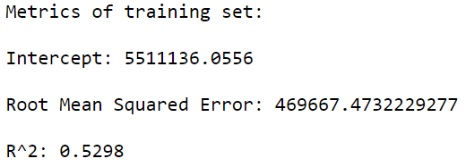
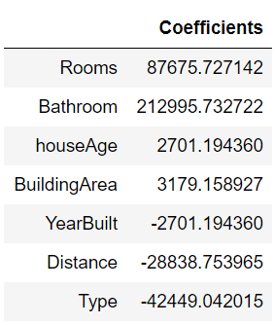
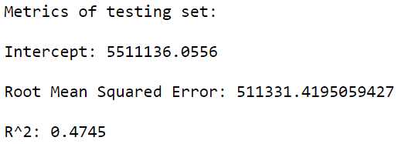
Observations

Slide 17
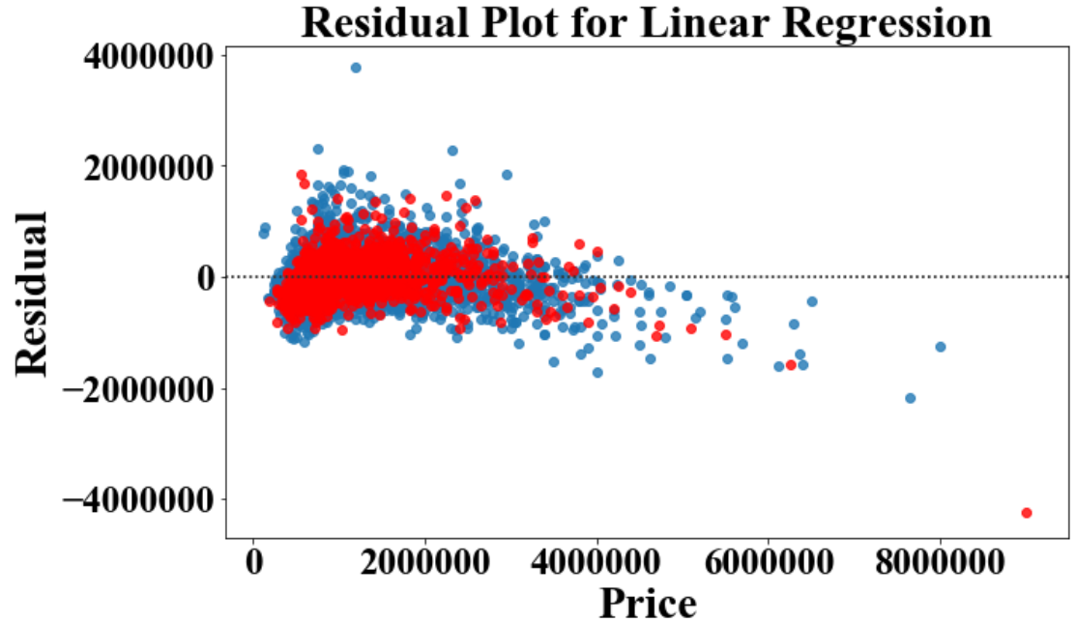

Slide 18
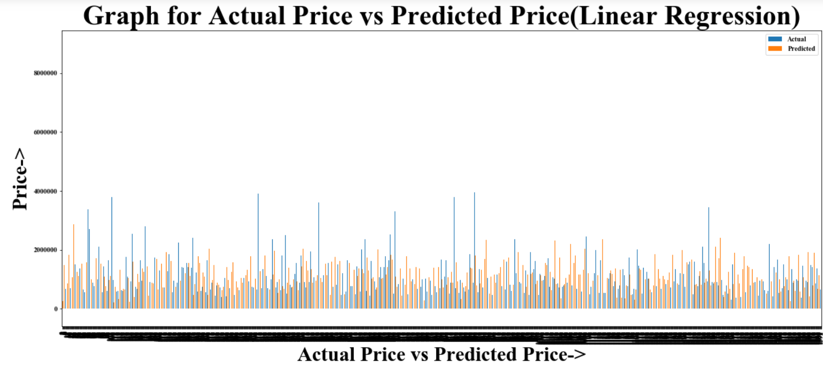

Slide 19
Observation -
As we can see, the predicted values and the actual have a big difference at some points.
Also, the Root Mean Square Value is 511331.42 which is very high.
Therefore, we can say that the Linear Regression model is not fit for this data.

Slide 20
Optimizing Linear Regression Model -
How to improve the model???
Using more training data, and by choosing more appropriate features which have high correlation to the values that we are trying to predict we can improve the R² value. So, resultantly the model will predict well.

Slide 21
Ridge Regression
Ridge Regression works by penalizing the magnitude of coefficients of features along with minimizing the error between predicted and actual observations. These are called ‘regularization’ techniques.
Ridge regression is used to create a parsimonious model in the following scenarios:
The number of predictor variables in a given set exceeds the number of observations.
The dataset has multicollinearity (correlations between predictor variables).
The regularization techniques are as follows:
Penalize the magnitude of coefficients of features
Minimize the error between the actual and predicted observations

Slide 22

Formula for ridge regression
Lambda is the hyperparameter.
RSS = sum of squared residuals

Slide 23
Steps to perform Ridge Regression:
Read the dataset
Separate the target variables from the independent variables
Fit and Train the model
Predict the model
Evaluate

Slide 24
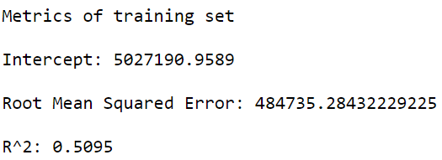
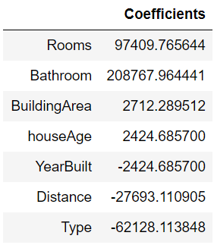
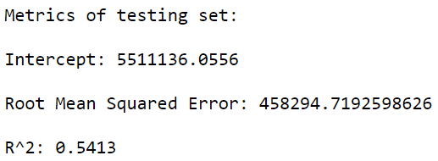
Evaluation

Slide 25
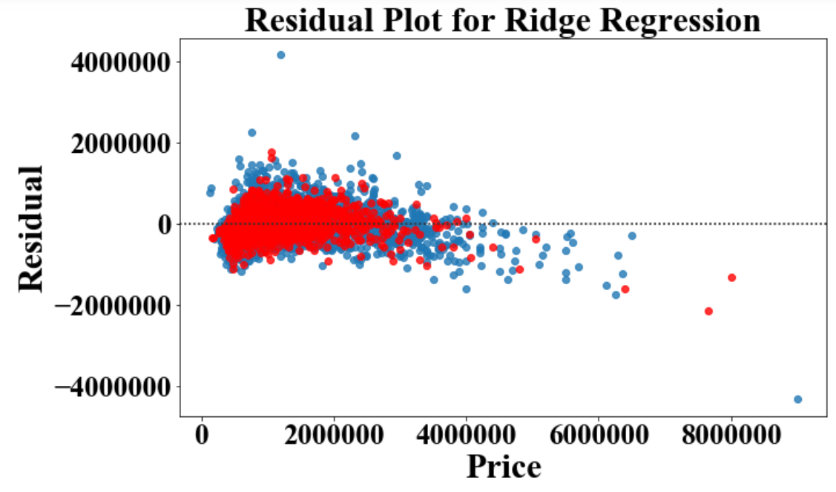

Slide 26
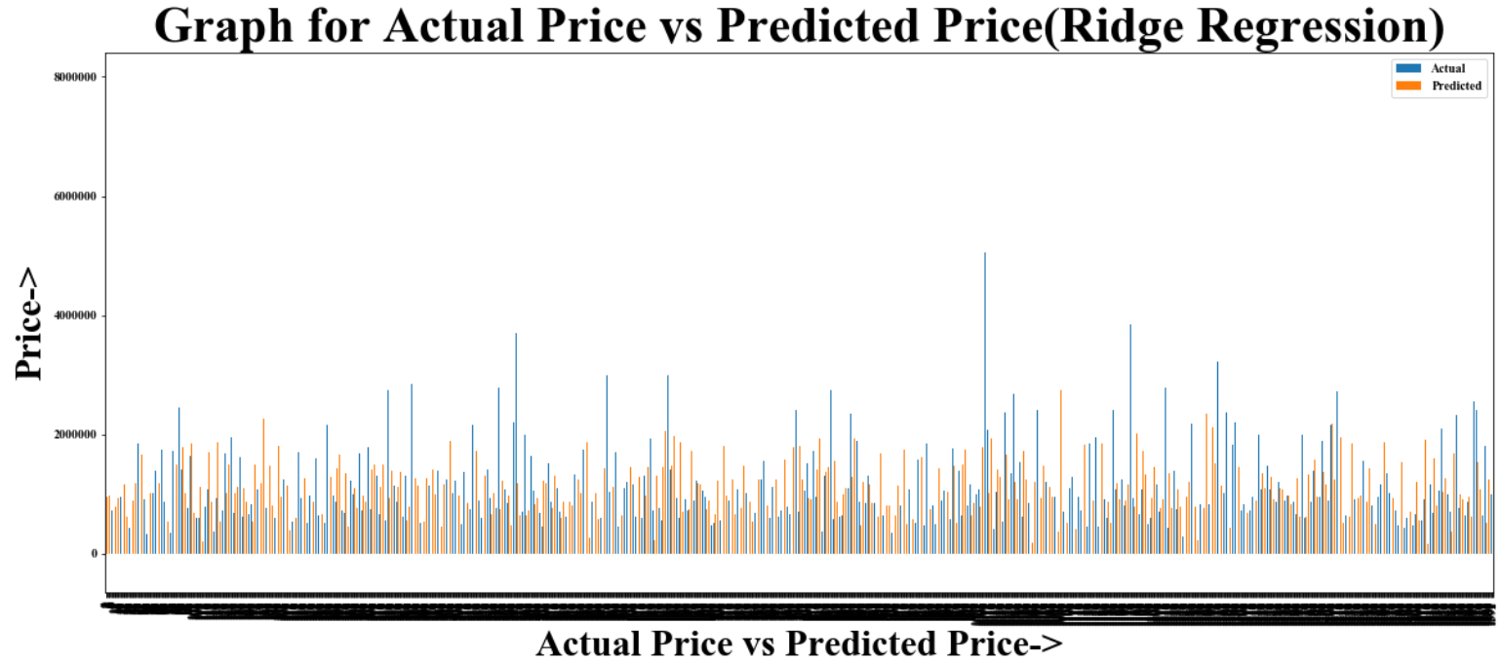

Slide 27
Observations
On comparing the RMSE values of Ridge regression and Linear regression, we can say that Ridge Regression is better than Linear Regression.
But the value is still high.
Therefore, we need to find that fits the data better than Ridge Regression.

Slide 28
Lasso Regression Model
Lasso regression is a type of linear regression that uses shrinkage. Shrinkage is where data values are shrunk towards a central point, like the mean. The lasso procedure encourages simple, sparse models (i.e. models with fewer parameters). This particular type of regression is well-suited for models showing high levels of multicollinearity or when you want to automate certain parts of model selection, like variable selection/parameter elimination.
Lasso uses L1 regularisation and it stands for Least Absolute Shrinkage and Selection Operator.
Here in this model , we have split the testing and training data subsets and Removed our prime aspect attribute to predict it: Prices
The testing model : 33%
The training model : 77%
We have used the K-fold cross validation so that it ensures that every observation from the original dataset has the chance of appearing in training and test set.

Slide 29
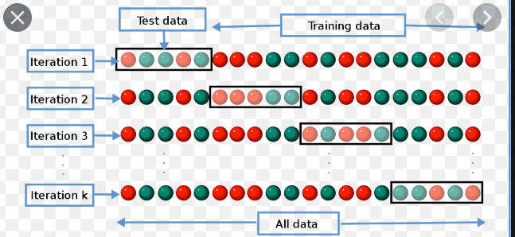
K-fold cross validation considers training on all but the kth part, and then validating on the kth part, iterating over k = 1, . . . K (When K = n, we call this leave-one-out cross-validation, because we leave out one data point at a time)
As we chose the regression model , lasso regression model gives us the least linear dependency and thus we have used the selected features in the correlation of the EDA.

Slide 30
THE PERFORMANCE EVALUATIONS PARAMETERS
Testing model:
Root Mean Square Error: 484147.7306
R-Squared: 0.5105
Training Model:
Root Mean Square Error: 468087.6284
R-Squared: 0.5475
Mean cross validated R^2: 0.5006
All values are obtained using the basic Algorithm of Linear Regression where the constraint Σ |Bj≤ s i.e the Sums of the squares is minimized in the lasso Algorithm

Slide 31
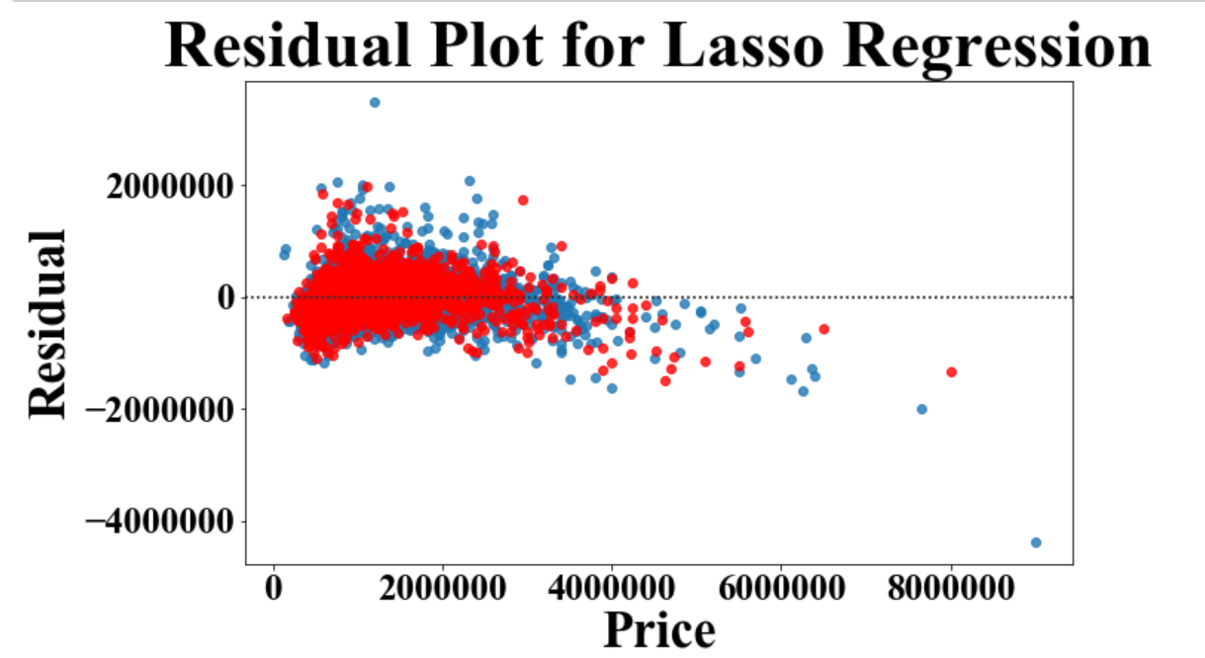
Residual Plot for Lasso Regression

Slide 32
Random Forest
A Random Forest is an ensemble technique capable of performing both regression and classification tasks with the use of multiple decision trees and a technique called Bootstrap Aggregation, commonly known as bagging. The basic idea behind this is to combine multiple decision trees in determining the final output rather than relying on individual decision trees.
Approach :
Pick at random K data points from the training set.
Build the decision tree associated with those K data points.
Choose the number Ntree of trees you want to build and repeat steps.
For a new data point, make each one of your Ntree trees predict the value of Y for the data point, and assign the new data point the average across all of the predicted Y values.
The estimator to use for this project is the RandomForestRegressor

Slide 33
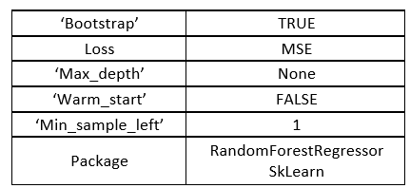
Using non-parametric model, performing RandomForestRegressor to predict the Price variable. A random forest is a meta estimator that fits a number of classifying decision trees on various sub-samples of the dataset and use averaging to improve the predictive accuracy and control over-fitting.
Some of the constant parameters throughout are :

Slide 34
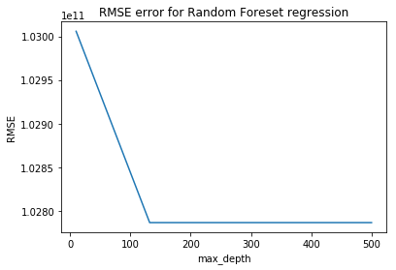

Parameters Tuned –
a.) 'max_depth': The maximum depth of the tree. If None, then nodes are expanded until all leaves are pure or until all leaves contain less than min_samples_split samples. The range of this is [10,132,255,377,500].
b.) 'n_estimators': The number of trees in the forest. The range is [10, 107, 205, 302, 400]
We plot a graph of MSE V/S Parameters. This is helpful in comparing the trend of parameters over error and compare it with the optimal results found by grid search

Slide 35
Using the random grid to search for best hyperparameter:
First creating the base model to tune
Random search of parameters, using the 3 fold cross validation search
Searching across 100 different combinations and using all available cores
Fitting the random search model

Slide 36
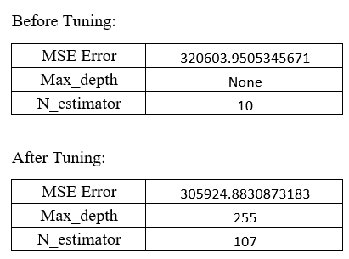
We used RandomizedSearchCV to perform parameter tuning with cv = 3. The parameters of the estimator used to apply these methods are optimized by cross-validated search over parameter settings.
Using the above we optimized my model to get the best parameters, we got the following results:

Slide 37
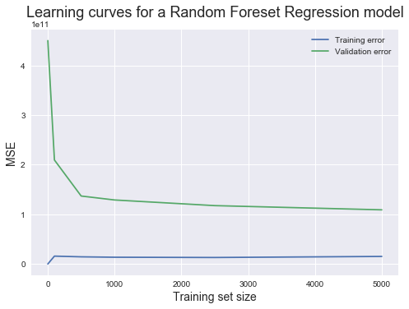
LEARNING CURVE OBSERVATIONS
The validation curve could converge toward the training curve if more training instances were added
This suggests that adding more training instances would help
As the training error upon converging is low, the model has a low bias / high variance problem.
As the gap between training error and validation error is large, it suggests high variance.
Also, due to low training error, we can conclude that the model overfits the training data.

Slide 38
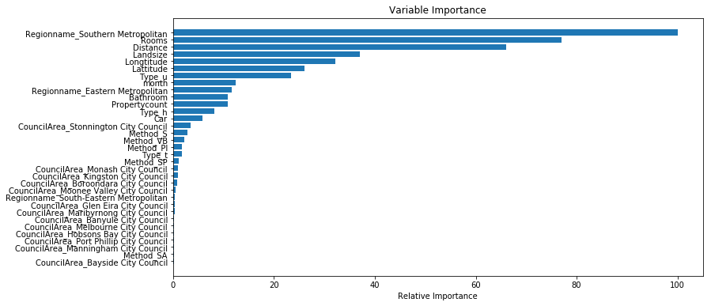
FEATURE SELECTION OBSERVATIONS
The following are the most import
variables are the most important features
These will be useful in comparing models in
Linear Models at the end

Slide 39
Gradient Boosting Regressor
GB builds an additive model in a forward stage-wise fashion; it allows for the optimization of arbitrary differentiable loss functions. In each stage a regression tree is fit on the negative gradient of the given loss function. Parameters which are constant throughout the model.
Loss | MSE
‘max_depth’ | 3
‘warm_start’ | False
Min_samples_leaf | 1
Package | GradientBoostingRegressorSKLearn

Slide 40
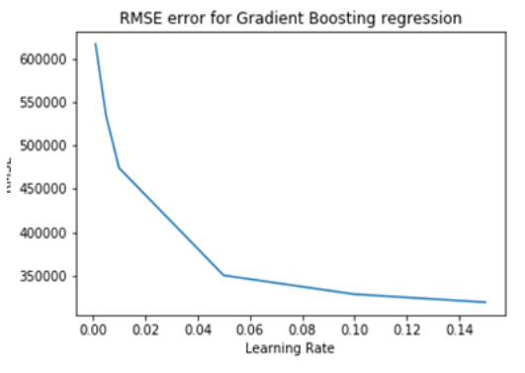
Gradient Boosting
Learning Rate: learning rate shrinks the contribution of each tree by learning rate.
There is a trade-off between learning rate and n_estimators, the range tested was [0.15, 0.1, 0.05, 0.01, 0.005, 0.001]

Slide 41
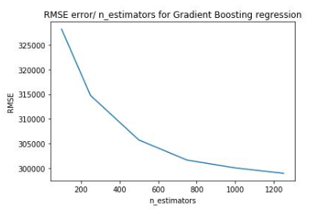
Gradient Boostinng Regressor – Parameter Tuning
No. of estimators: The number of boosting stages to perform. Gradient boosting is fairly robust to over-fitting, so a large number usually results in better performance.

Slide 42
Gradient Boostinng for Parameters
We used the following parameters for Gradient Boosting changing only learning parameters and no. of estimators.{max_depth=4, min_samples_split=2, min_samples_leaf=1, subsample=1, max_features=‘sqrt’, random_state=10), param_grid=p_test3, scoring=‘explained_variance’, n_jobs=4, iid=False, cv=5}
We used RandomizedSearchCV to perform parameter tuning with cv = 3. The parameters of the estimator used to apply these methods are optimized by cross-validated search over parameter settings
Before Tuning After Tuning
RMSE | 328264.78586698597
Learning_rate | 0.1
No. of estimators | 100
RMSE | 291220.3456978203
Learning_rate | 0.1
No. of estimators | 750

Slide 43
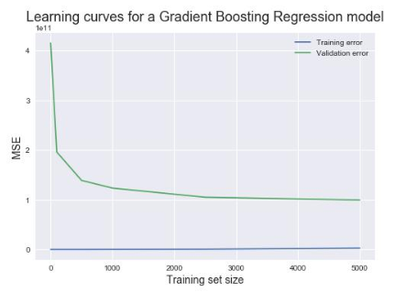
Gradient Observations
Learning Curves:
The validation curve could converge toward the training curve if more training instances were added
As the training error upon converging is low, the model has a low bias/high variance problem
As the gap between training error and validation error is large, it suggests high variance. Also, due to near zero training error, we conclude, that the model overfits the training data

Slide 44
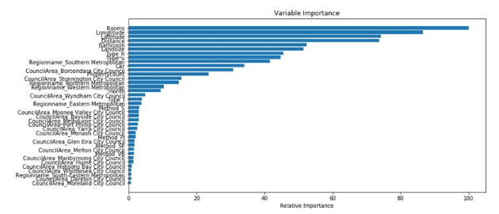
Observations
Feature Selection:
The following are the most importance variables are the most important features
These will be useful in comparing models in building modified model at the end

Slide 45
Optimizing Using Ensemble Methodology
Ensemble methods are used to use predictions of several weak estimators built to improve generalization/ robustness over a single estimator.
Boosting methods - Base estimators are built sequentially and one tries to reduce the bias of the combined estimator. It aims in improving accuracy of week model. we apply base learning (ML) algorithms with a different distribution. Each time base learning algorithm is applied, it generates a new weak prediction rule. This is an iterative process. After many iterations, the boosting algorithm combines these weak rules into a single strong prediction rule.
Methodology Using GBM-
We used the clusters created earlier and assign them as feature. As they are categorical variable, they get converted to One hot vectors. Rest of the features remain the same.

Slide 46
Results of the Hypertuned GBM Model-
Tuned the new GBM on the same set of parameters range as earlier (n_estimators, learning rate) and max depth of a single tree which is tuned over the range {'max_depth':[2,3,4,5,6,7] }.
Model | MSE
GBM (pre-feature selection, tuned | 291257.119966
GBM (feature selection, not tuned | 334113.86904414993
GBM (feature selection, tuned) | 292033.3933783364

Slide 47
Comparison
Model | MSE (Tuned/Best Model)
Random Forest Regressor | 305924.8830873183
Gradient Boosting regressor | 291257.119966
Linear Regression | 511331.4195059427
Ridge Regression | 458294.7192598626
Lasso Regression | 468087.6284

Slide 48
Comparison
1. Ridge V/s Lasso- Lasso doesn’t significantly reduce the RMSE error significantly but Lasso is useful in feature selection which is used in the future models saving computation. Ridge doesn’t do feature selection. Ridge is computationally less expensive than Lasso.
2. Random Forest V/s Gradient Boosting Machine – GBM is the best performing model after parameter tuning. There is not a huge effect in the accuracy. However Random Forest Regressor is more computationally effect.
3. Ridge/Lasso V/s Linear Regression V/s Subset Selection – I chose Ridge and Lasso regression over other Linear regression methods as they have a regularization effect which worked well with the high dimensional dataset I had. Linear model was too simplified to correct model this data and subset selection was computationally expensive due to the large number of features.
4. Random Forest/ Gradient Boosting Machine V/s KNN – KNN would have been computationally expensive and I was not convinced with my cluster results in the previous results. Due to poor clusters, I anticipated KNN to perform poorly. On the other hand, Boosting and Random Forest base on Decision Trees which can learn complex models.

Slide 49
Future Scope
In Future, we wish to use below methodology to further improve results by hyper tuning best selected features as hyper parameters predicted by random forest model using GBM -
For feature selection, Random Forest provides mean decrease impurity and mean decrease accuracy. Random forest consists of several decision trees. Every node in the decision trees is a condition on a single feature, designed to split the dataset into two so that similar response values end up in the same set. The measure based on which the (node) optimal condition is chosen is called impurity (variance). Using the training set, it computes how much each feature decreases the weighted impurity in a tree. Combining these decision trees (Forest) the impurity decreases from each feature which is averaged and ranked to give the most important features. As a result, we can use top n features from Random Forest and input those into the boosting model. The n feature becomes a hyperparameter and can be tuned. We haven’t tuned it in this section, but this can be done to improve future results.

Slide 50
Conclusion
Final Observations:
We observe that with the selected feature selection method doesn’t work well. Perhaps, tuning the number of feature to include from Random Forest would improve the feature.
Also, we haven’t scaled any features, doing that in the future can improve accuracy
The overall computation time of the modified model has decreased with considerable improvement in error.

